Slide 1

CONSERVATIVE NUMERICAL INTEGRATORS VIA AUXILIARY VARIABLES
Boris Andrews | Patrick Farrell
SIAM CSE25 (MS2⁷)
March 4th 2025
Notes:
Very happy to be opening the 2nd session!
Thank you all for coming, and thanks for having me, and giving me the chance to tell about some work of which I’m very proud…

Slide 2

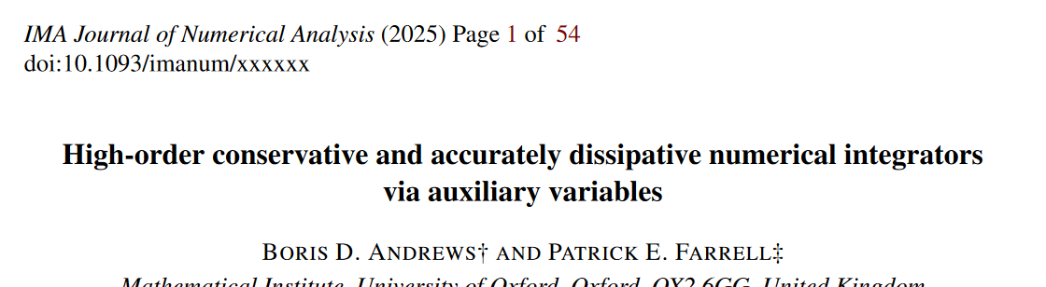
CONSERVATIVE NUMERICAL INTEGRATORS VIA AUXILIARY VARIABLES
Boris Andrews | Patrick Farrell
SIAM CSE25 (MS2⁷)
March 4th 2025
Notes:
Long, long preprint from last year with my supervisor, Patrick Farrell
Cardinal sin: Unlikely to discuss non-Newtonian fluids till the very end

Slide 3
0. KEY FINDINGS (TL;DR…)

Slide 4


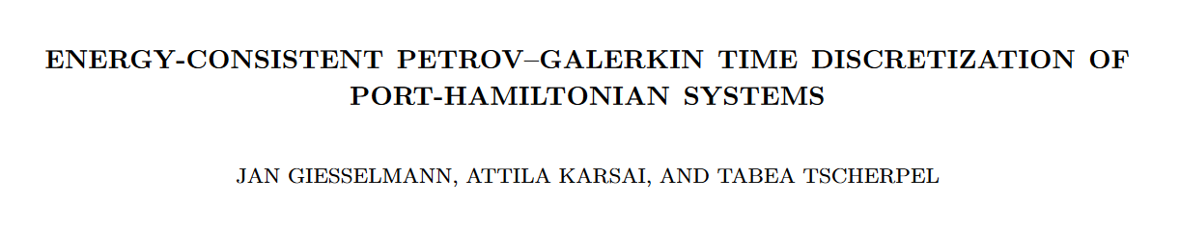
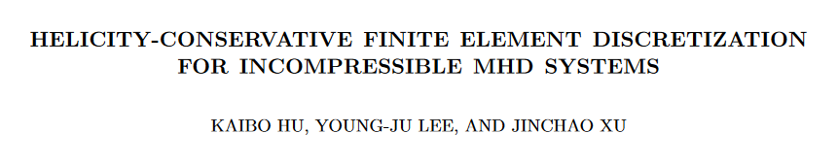
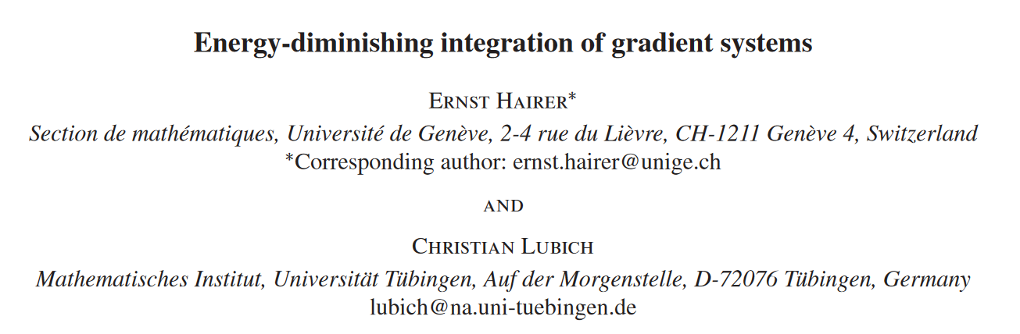
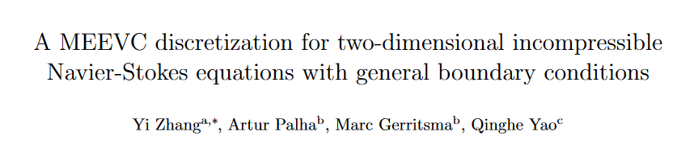
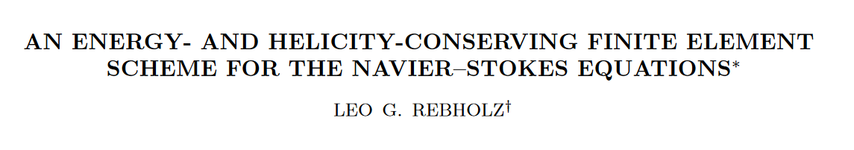
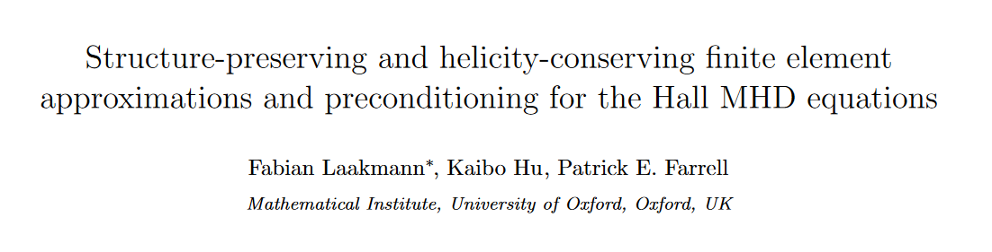
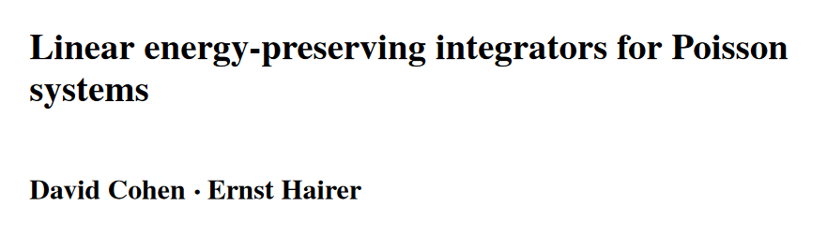
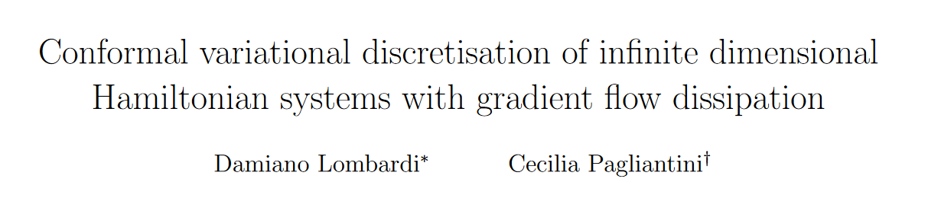
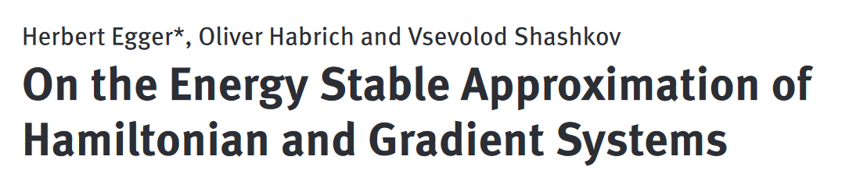

0. KEY FINDINGS (TL;DR…)
Introduced a framework for modifies a given integrator to preserve any* chosen conservation/dissipation law!
WHAT HAVE YOU DONE?
HOW NOVEL
IS THIS?
Reproduces many existing schemes
Allows us to tackle many new problems

Slide 5
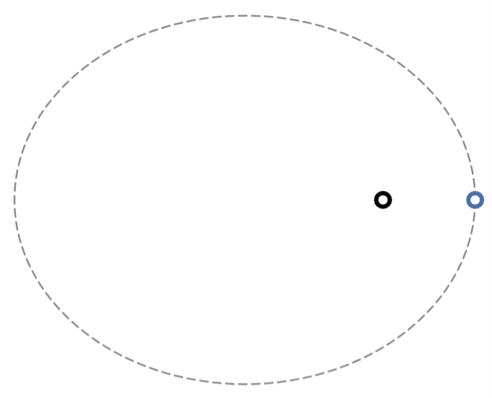
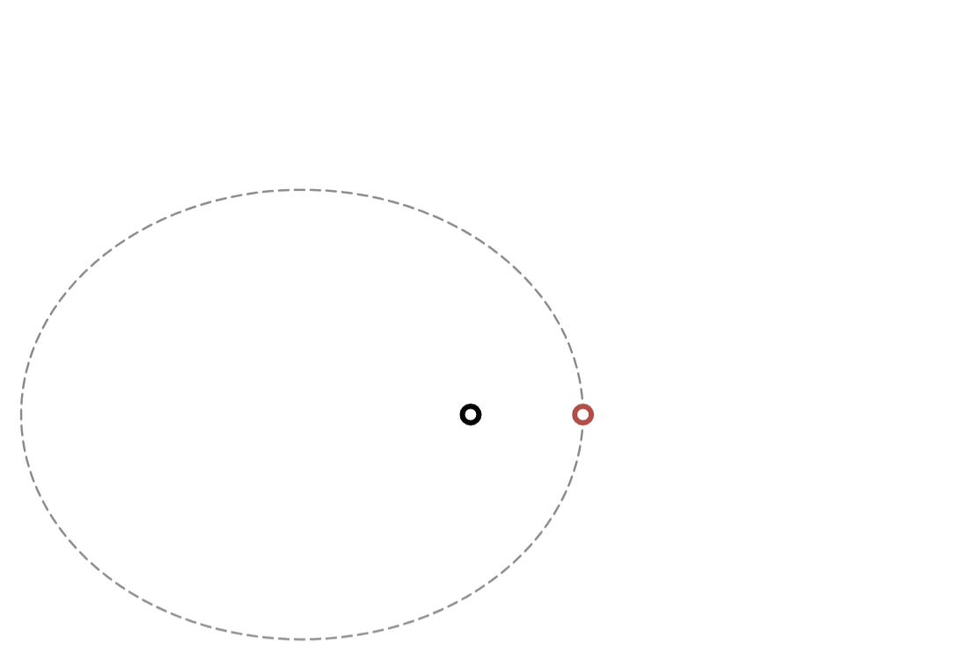
0. KEY FINDINGS (TL;DR…)
Introduced a framework for modifies a given integrator to preserve any* chosen conservation/dissipation law!
WHAT HAVE YOU DONE?
HOW NOVEL
IS THIS?
Reproduces many existing schemes
Allows us to tackle many new problems
Our fully conservative integrator
Integrators for conservative ODEs that conserve all known invariants!
Implicit midpoint

Slide 6
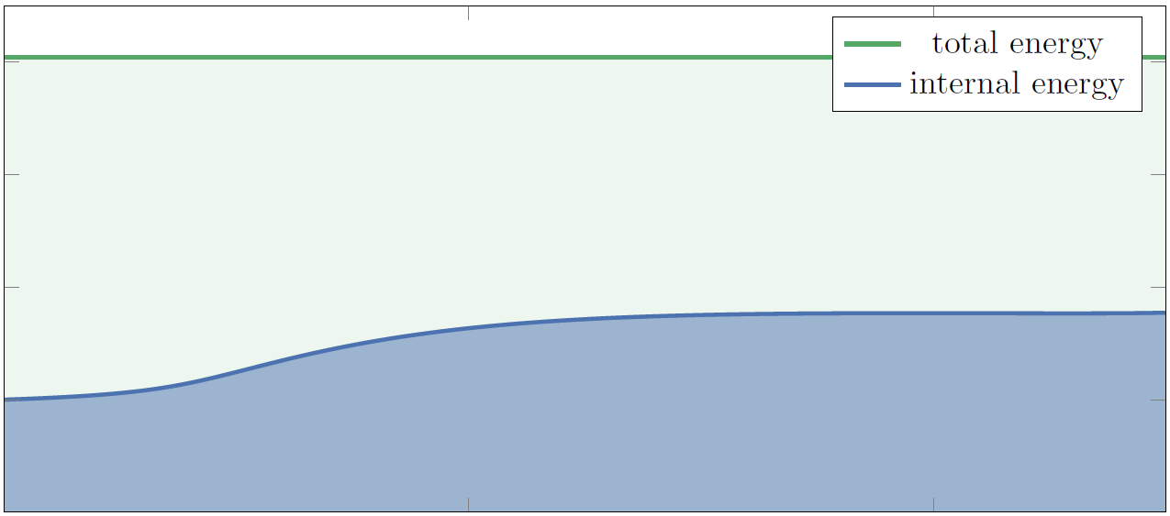
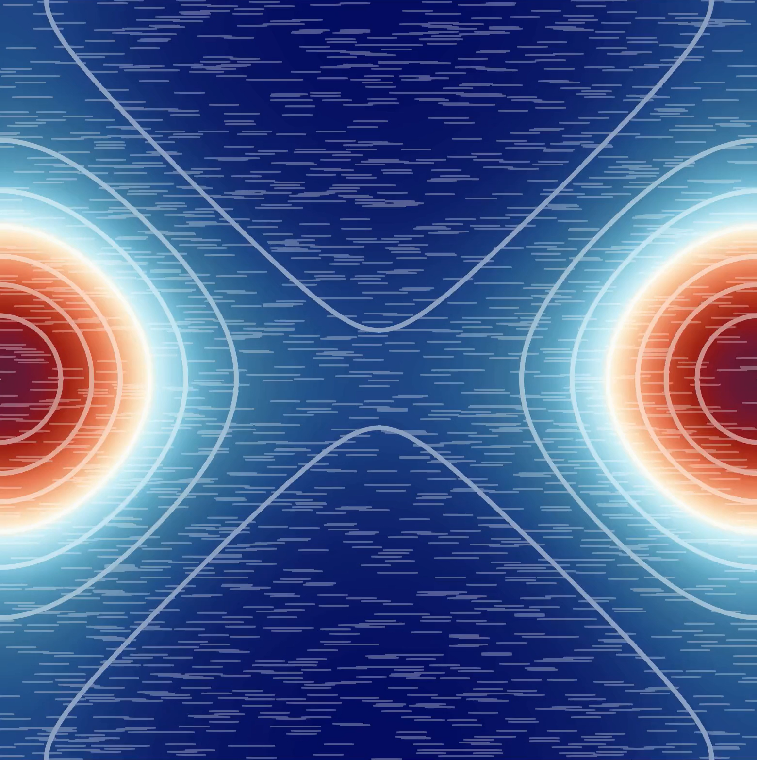
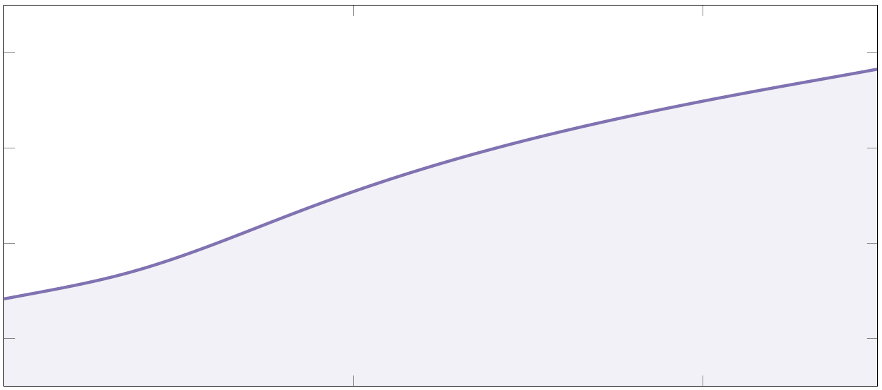
0. KEY FINDINGS (TL;DR…)
Introduced a framework for modifies a given integrator to preserve any* chosen conservation/dissipation law!
WHAT HAVE YOU DONE?
HOW NOVEL
IS THIS?
Reproduces many existing schemes
Allows us to tackle many new problems
Integrators for compressible Navier–Stokes that both conserve energy and dissipate entropy!

Slide 7
0. KEY FINDINGS (TL;DR…)
Introduced a framework for modifies a given integrator to preserve any* chosen conservation/dissipation law!
WHAT HAVE YOU DONE?
HOW NOVEL
IS THIS?
Reproduces many existing schemes
Allows us to tackle many new problems
HOW DOES THAT WORK?
Systematic introduction of
auxiliary variables
Finite elements
in time
Inherently mixed methods
(TL;DR…) An alternative to Runge–Kutta

Slide 8
0. KEY FINDINGS (TL;DR…)
Introduced a framework for modifies a given integrator to preserve any* chosen conservation/dissipation law!
WHAT HAVE YOU DONE?
HOW NOVEL
IS THIS?
Reproduces many existing schemes
Allows us to tackle many new problems
HOW DOES THAT WORK?
Mimic continuous-level proofs of these structures, on the discrete level
Structure-preserving integrators:
Give greater qualitative accuracy, especially at long durations
Are often more reliable, in terms of e.g. existence of solutions
And our framework is simple, general, and often the only real way to preserve certain structures for certain systems!
WHY SHOULD I CARE?

Slide 9
0. KEY FINDINGS (TL;DR…)
Introduced a framework for modifies a given integrator to preserve any* chosen conservation/dissipation law!
WHAT HAVE YOU DONE?
HOW NOVEL
IS THIS?
Reproduces many existing schemes
Allows us to tackle many new problems
HOW DOES THAT WORK?
Systematic introduction of
auxiliary variables
Finite elements
in time
Structure-preserving integrators:
Give greater qualitative accuracy, especially at long durations
Are often more reliable, in terms of e.g. existence of solutions
And our framework is simple, general, and often the only real way to preserve certain structures for certain systems!
WHY SHOULD I CARE?

Slide 10
1. FINITE ELEMENTS IN TIME (FET)

Slide 11
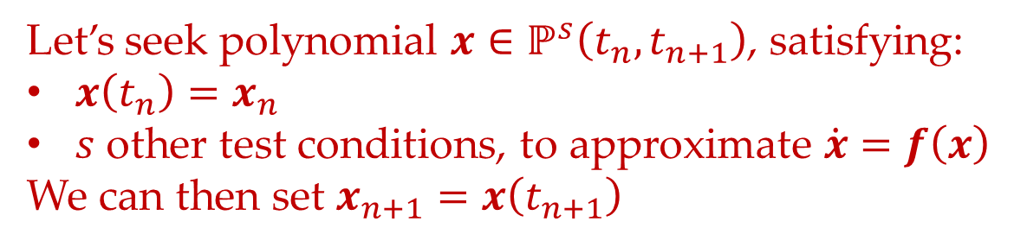
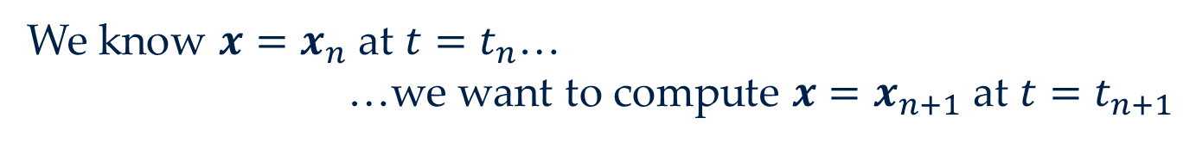

1. FINITE ELEMENTS IN TIME (FET)
To understand FET, consider the general ODE
$$\dot{x}=f\left(x\right)$$
We know $x=x_{n}$ at $t=t_{n}$…
…we want to compute $x=x_{n+1}$ at $t=t_{n+1}$
General idea (Of many single-step integrators)
Let’s seek polynomial $x∈ℙ^{s}\left(t_{n},t_{n+1}\right)$, satisfying:
$x\left(t_{n}\right)=x_{n}$
$s$ other test conditions, to approximate $\dot{x}=f\left(x\right)$
We can then set $x_{n+1}=x\left(t_{n+1}\right)$

Slide 12
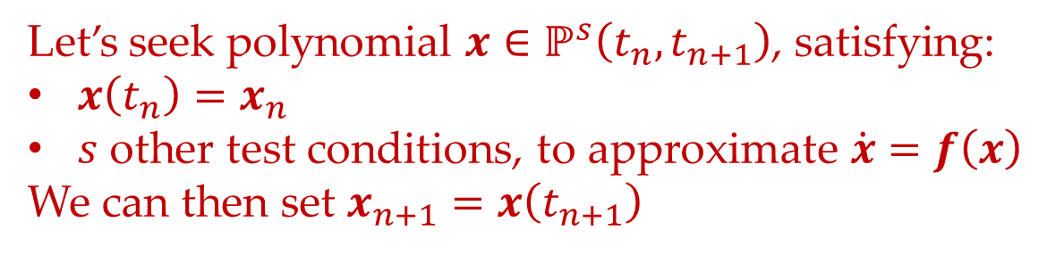
1. FINITE ELEMENTS IN TIME (FET)
General idea (Of many single-step integrators)
Let’s seek polynomial $x∈ℙ^{s}\left(t_{n},t_{n+1}\right)$, satisfying:
$x\left(t_{n}\right)=x_{n}$
$s$ other test conditions, to approximate $\dot{x}=f\left(x\right)$
We can then set $x_{n+1}=x\left(t_{n+1}\right)$
Example (Any collocation Runge–Kutta method, e.g. Gauss, Radau IIA, …)
Find $x∈ℙ^{s}\left(t_{n},t_{n+1}\right)$ such that $\dot{x}=f\left(x\right)$ at $t∈t_{n}+\left\{c_{1}Δt_{n},…,c_{s}Δt_{n}\right\}$…
…then set $x_{n+1}=x\left(t_{n+1}\right)$

Slide 13
1. FINITE ELEMENTS IN TIME (FET)
General idea (Of many single-step integrators)
Let’s seek polynomial $x∈ℙ^{s}\left(t_{n},t_{n+1}\right)$, satisfying:
$x\left(t_{n}\right)=x_{n}$
$s$ other test conditions, to approximate $\dot{x}=f\left(x\right)$
We can then set $x_{n+1}=x\left(t_{n+1}\right)$
Example (Continuous Petrov–Galerkin (CPG))
Find $x∈ℙ^{s}\left(t_{n},t_{n+1}\right)$ such that $\int_{t_{n}}^{t_{n+1}}{\dot{x}⋅y}=\int_{t_{n}}^{t_{n+1}}{f\left(x\right)⋅y}$ for all $y∈ℙ^{s−1}\left(t_{n},t_{n+1}\right)$…
…then set $x_{n+1}=x\left(t_{n+1}\right)$

Slide 14
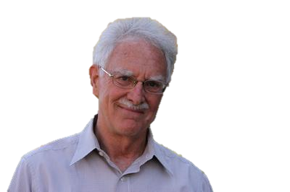
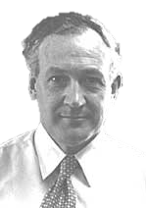
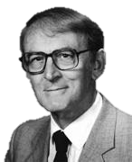
2. EXAMPLE (BBM)
1. TIMESTEPPING DEFINITION
2. TEST FUNCTION IDENTIFICATION
3. AV INTRODUCTION
4. RHS MODIFICATION

Slide 15

2. EXAMPLE (BBM)
While the framework is very general, let’s work with the Benjamin–Bona–Mahony (BBM) equation to fix ideas…
$$\dot{u}−{\dot{u}}_{xx}=−u_{x}−uu_{x}$$
This is a Hamiltonian PDE with energy…
$$ℋ=\int{\frac{1}{2}u^{2}+\frac{1}{6}u^{3}}$$
$$\dot{ℋ}=\int{\left(u+\frac{1}{2}u^{2}\right)\dot{u}}$$

Slide 16
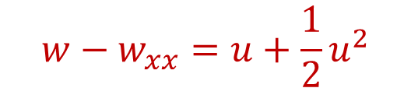
2. EXAMPLE (BBM)
While the framework is very general, let’s work with the Benjamin–Bona–Mahony (BBM) equation to fix ideas…
$$\dot{u}−{\dot{u}}_{xx}=−u_{x}−uu_{x}$$
This is a Hamiltonian PDE with energy…
$$w−w_{xx}=u+\frac{1}{2}u^{2}$$
$$ℋ=\int{\frac{1}{2}u^{2}+\frac{1}{6}u^{3}}$$
$$\dot{ℋ}=\int{\left(w−w_{xx}\right)\dot{u}}$$

Slide 17
2. EXAMPLE (BBM)
While the framework is very general, let’s work with the Benjamin–Bona–Mahony (BBM) equation to fix ideas…
$$\dot{u}−{\dot{u}}_{xx}=−u_{x}−uu_{x}$$
This is a Hamiltonian PDE with energy…
$$w−w_{xx}=u+\frac{1}{2}u^{2}$$
$$ℋ=\int{\frac{1}{2}u^{2}+\frac{1}{6}u^{3}}$$
$$\dot{ℋ}=\int{w\left(\dot{u}−{\dot{u}}_{xx}\right)}=−\int{w{\left(w−w_{xx}\right)}_{x}}=−\frac{1}{2}\int{{\left(w^{2}−w_{x}^{2}\right)}_{x}}=0$$

Slide 18
2. EXAMPLE (BBM)
While the framework is very general, let’s work with the Benjamin–Bona–Mahony (BBM) equation to fix ideas…
$$\dot{u}−{\dot{u}}_{xx}=−u_{x}−uu_{x}$$
This is a Hamiltonian PDE with energy…
$$w−w_{xx}=u+\frac{1}{2}u^{2}$$
$$ℋ=\int{\frac{1}{2}u^{2}+\frac{1}{6}u^{3}}$$
$$\dot{ℋ}=\int{w\left(\dot{u}−{\dot{u}}_{xx}\right)}=\int{w\left(−u_{x}−uu_{x}\right)}$$

Slide 19
2. EXAMPLE (BBM)
While the framework is very general, let’s work with the Benjamin–Bona–Mahony (BBM) equation to fix ideas…
$$\dot{u}−{\dot{u}}_{xx}=−u_{x}−uu_{x}$$
This is a Hamiltonian PDE with energy…
$$w−w_{xx}=u+\frac{1}{2}u^{2}$$
$$ℋ=\int{\frac{1}{2}u^{2}+\frac{1}{6}u^{3}}$$
$$\dot{ℋ}=\int{w\left(\dot{u}−{\dot{u}}_{xx}\right)}=−\int{w{\left(u+\frac{1}{2}u^{2}\right)}_{x}}$$

Slide 20
2. EXAMPLE (BBM)
While the framework is very general, let’s work with the Benjamin–Bona–Mahony (BBM) equation to fix ideas…
$$\dot{u}−{\dot{u}}_{xx}=−u_{x}−uu_{x}$$
This is a Hamiltonian PDE with energy…
$$w−w_{xx}=u+\frac{1}{2}u^{2}$$
$$ℋ=\int{\frac{1}{2}u^{2}+\frac{1}{6}u^{3}}$$
$$\dot{ℋ}=\int{w\left(\dot{u}−{\dot{u}}_{xx}\right)}=−\int{w{\left(w−w_{xx}\right)}_{x}}=−\frac{1}{2}\int{{\left(w^{2}−w_{x}^{2}\right)}_{x}}=0$$

Slide 21
2. EXAMPLE (BBM)
While the framework is very general, let’s work with the Benjamin–Bona–Mahony (BBM) equation to fix ideas…
$$\dot{u}−{\dot{u}}_{xx}=−u_{x}−uu_{x}$$
This is a Hamiltonian PDE with energy…
$$w−w_{xx}=u+\frac{1}{2}u^{2}$$
$$ℋ=\int{\frac{1}{2}u^{2}+\frac{1}{6}u^{3}}$$
$$\dot{ℋ}=\int{w\left(\dot{u}−{\dot{u}}_{xx}\right)}=−\int{w{\left(w−w_{xx}\right)}_{x}}=−\frac{1}{2}\int{{\left(w^{2}−w_{x}^{2}\right)}_{x}}=0$$

Slide 22
2. EXAMPLE (BBM)
While the framework is very general, let’s work with the Benjamin–Bona–Mahony (BBM) equation to fix ideas…
$$\dot{u}−{\dot{u}}_{xx}=−u_{x}−uu_{x}$$
This is a Hamiltonian PDE with energy…
$$w−w_{xx}=u+\frac{1}{2}u^{2}$$
$$ℋ=\int{\frac{1}{2}u^{2}+\frac{1}{6}u^{3}}$$
$$\dot{ℋ}=\int{w\left(\dot{u}−{\dot{u}}_{xx}\right)}=−\int{w{\left(w−w_{xx}\right)}_{x}}=−\frac{1}{2}\int{{\left(w^{2}−w_{x}^{2}\right)}_{x}}=0$$

Slide 23



DISCLAIMER!
The energy-conserving scheme given by our framework will give will be identical to that proposed in:

Slide 24
DISCLAIMER!
I’m just using it as a demo for the framework ☺

Slide 25
2. EXAMPLE (BBM)
1. TIMESTEPPING DEFINITION
2. TEST FUNCTION IDENTIFICATION
3. AV INTRODUCTION
4. RHS MODIFICATION

Slide 26
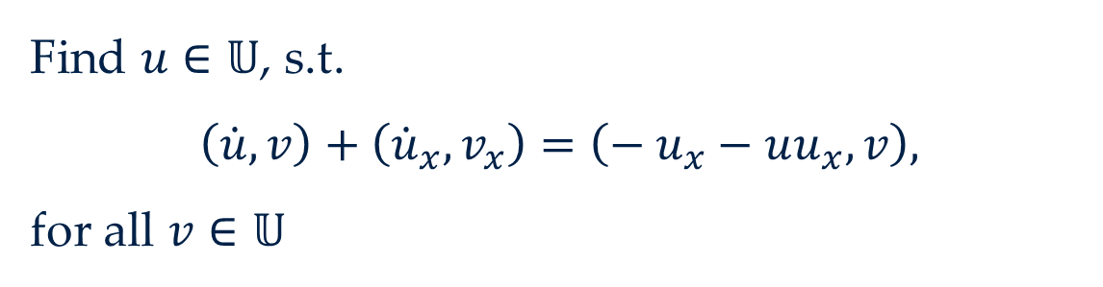

2. EXAMPLE (BBM) | 1. TIMESTEPPING DEFINITION
$$\dot{u}−{\dot{u}}_{xx}=− u_{x}−uu_{x}$$
Semi-discretisation
Find $u∈𝕌$, s.t.
$$\left(\dot{u},v\right)+\left({\dot{u}}_{x},v_{x}\right)=\left(− u_{x}−uu_{x},v\right),$$
for all $v∈𝕌$

Slide 27
2. EXAMPLE (BBM) | 1. TIMESTEPPING DEFINITION
A. Define CPG discretisation
Discretise semi-discretisation in time using CPG
Semi-discretisation
Find $u∈𝕌$, s.t.
$$\left(\dot{u},v\right)+\left({\dot{u}}_{x},v_{x}\right)=\left(− u_{x}−uu_{x},v\right),$$
for all $v∈𝕌$

Slide 28
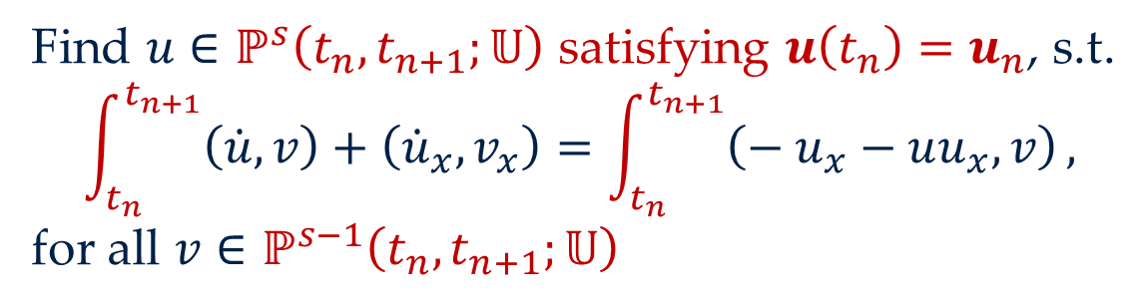
2. EXAMPLE (BBM) | 1. TIMESTEPPING DEFINITION
A. Define CPG discretisation
Discretise semi-discretisation in time using CPG
Full CPG discretisation
Find $u∈ℙ^{s}\left(t_{n},t_{n+1};𝕌\right)$ satisfying $u\left(t_{n}\right)=u_{n}$, s.t.
$$\int_{t_{n}}^{t_{n+1}}{\left(\dot{u},v\right)+\left({\dot{u}}_{x},v_{x}\right)}=\int_{t_{n}}^{t_{n+1}}{\left(− u_{x}−uu_{x},v\right)},$$
for all $v∈ℙ^{s−1}\left(t_{n},t_{n+1};𝕌\right)$

Slide 29
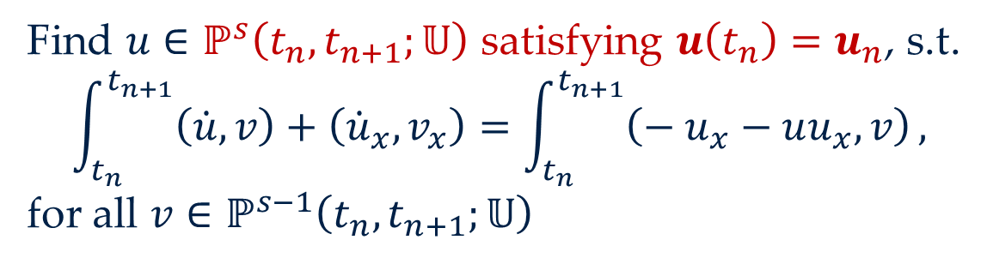

2. EXAMPLE (BBM) | 1. TIMESTEPPING DEFINITION
A. Define CPG discretisation
Discretise semi-discretisation in time using CPG
Full CPG discretisation
Let’s just call this $𝕏$…
Find $u∈ℙ^{s}\left(t_{n},t_{n+1};𝕌\right)$ satisfying $u\left(t_{n}\right)=u_{n}$, s.t.
$$\int_{t_{n}}^{t_{n+1}}{\left(\dot{u},v\right)+\left({\dot{u}}_{x},v_{x}\right)}=\int_{t_{n}}^{t_{n+1}}{\left(− u_{x}−uu_{x},v\right)},$$
for all $v∈ℙ^{s−1}\left(t_{n},t_{n+1};𝕌\right)$

Slide 30
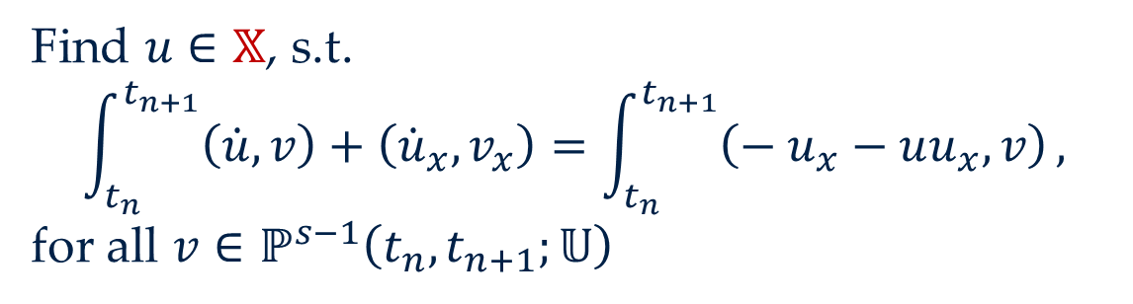
2. EXAMPLE (BBM) | 1. TIMESTEPPING DEFINITION
A. Define CPG discretisation
Discretise semi-discretisation in time using CPG
Full CPG discretisation
Let’s just call this $𝕏$…
Find $u∈𝕏$, s.t.
$$\int_{t_{n}}^{t_{n+1}}{\left(\dot{u},v\right)+\left({\dot{u}}_{x},v_{x}\right)}=\int_{t_{n}}^{t_{n+1}}{\left(− u_{x}−uu_{x},v\right)},$$
for all $v∈ℙ^{s−1}\left(t_{n},t_{n+1};𝕌\right)$

Slide 31
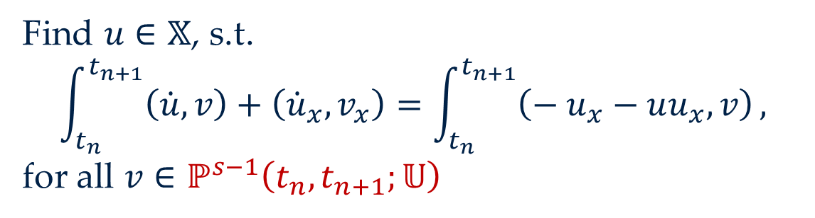
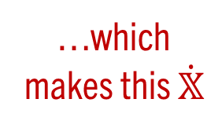
2. EXAMPLE (BBM) | 1. TIMESTEPPING DEFINITION
A. Define CPG discretisation
Discretise semi-discretisation in time using CPG
Full CPG discretisation
Let’s just call this $𝕏$…
Find $u∈𝕏$, s.t.
$$\int_{t_{n}}^{t_{n+1}}{\left(\dot{u},v\right)+\left({\dot{u}}_{x},v_{x}\right)}=\int_{t_{n}}^{t_{n+1}}{\left(− u_{x}−uu_{x},v\right)},$$
for all $v∈ℙ^{s−1}\left(t_{n},t_{n+1};𝕌\right)$
…which makes this $\dot{𝕏}$

Slide 32
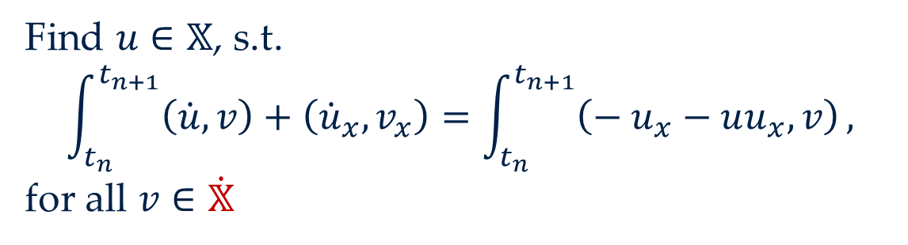
2. EXAMPLE (BBM) | 1. TIMESTEPPING DEFINITION
A. Define CPG discretisation
Discretise semi-discretisation in time using CPG
Full CPG discretisation
Let’s just call this $𝕏$…
Find $u∈𝕏$, s.t.
$$\int_{t_{n}}^{t_{n+1}}{\left(\dot{u},v\right)+\left({\dot{u}}_{x},v_{x}\right)}=\int_{t_{n}}^{t_{n+1}}{\left(− u_{x}−uu_{x},v\right)},$$
for all $v∈\dot{𝕏}$
…which makes this $\dot{𝕏}$

Slide 33
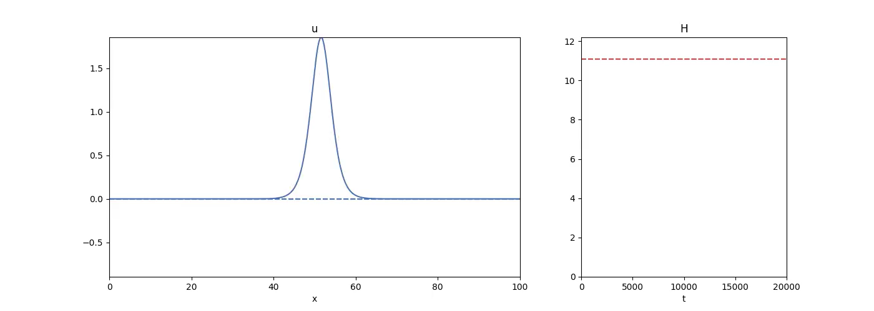

2. EXAMPLE (BBM) | 1. TIMESTEPPING DEFINITION
$$u$$
Energy

Slide 34
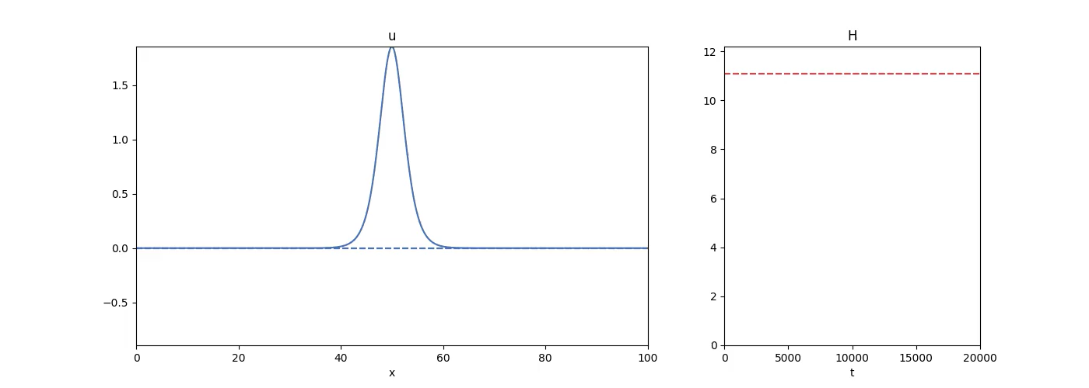
2. EXAMPLE (BBM) | 1. TIMESTEPPING DEFINITION
$$u$$
Energy

Slide 35
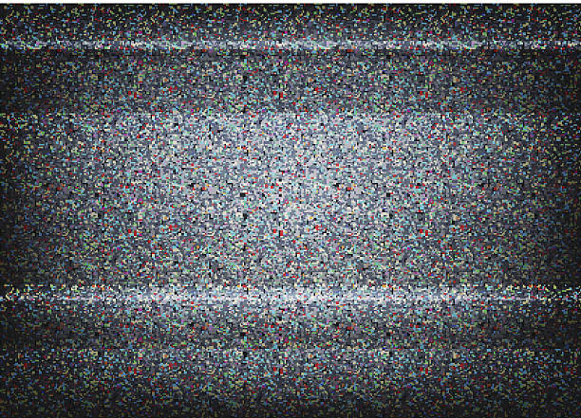
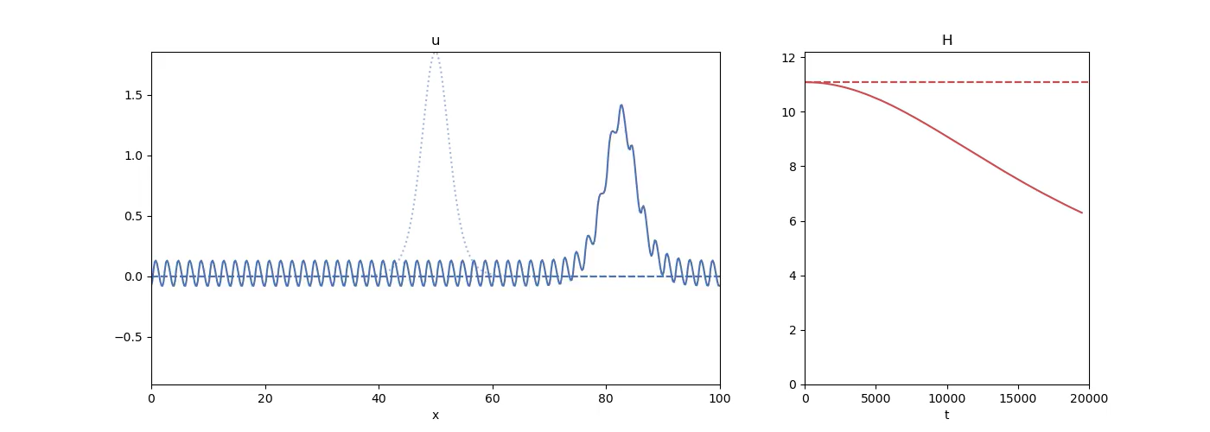
2. EXAMPLE (BBM) | 1. TIMESTEPPING DEFINITION
$$u$$
Energy

Slide 36
2. EXAMPLE (BBM)
1. TIMESTEPPING DEFINITION
2. TEST FUNCTION IDENTIFICATION
3. AV INTRODUCTION
4. RHS MODIFICATION

Slide 37
2. EXAMPLE (BBM) | 2. TEST FUNCTION IDENTIFICATION
B. Identify associated test functions
For each structure to be preserved, identify its associated test function
Each conservation/dissipation structure has an “associated test function”
To show what I mean, consider $\dot{ℋ}$…
$$\dot{ℋ}=\int{\left(\dot{u}w+{\dot{u}}_{x}w_{x}\right)}=\int{\left(−u_{x}−uu_{x}\right)w}=−\frac{1}{2}\int{{\left(w^{2}−w_{x}^{2}\right)}_{x}}=0$$

Slide 38
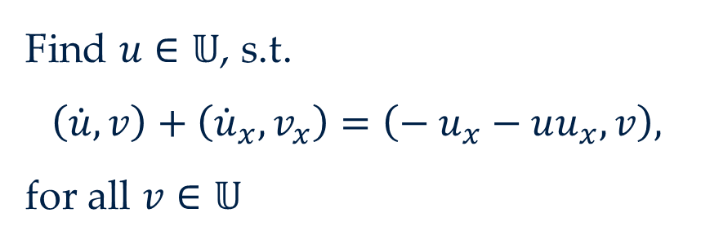
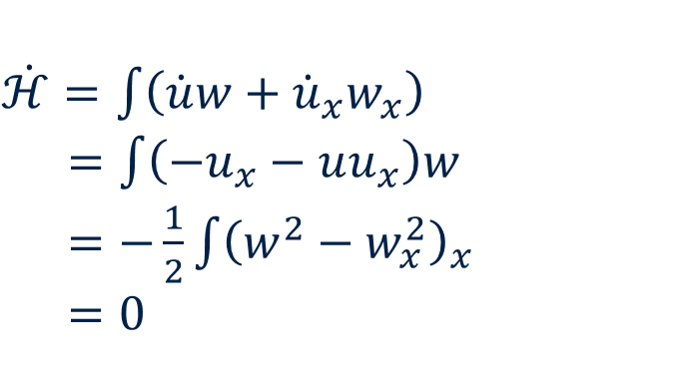
2. EXAMPLE (BBM) | 2. TEST FUNCTION IDENTIFICATION
B. Identify associated test functions
For each structure to be preserved, identify its associated test function
Each conservation/dissipation structure has an “associated test function”
Semi-discretisation
$\dot{ℋ}=\int{\left(\dot{u}w+{\dot{u}}_{x}w_{x}\right)}$
$=\int{\left(−u_{x}−uu_{x}\right)w}$
$=−\frac{1}{2}\int{{\left(w^{2}−w_{x}^{2}\right)}_{x}}$
$=0$
Find $u∈𝕌$, s.t.
$$\left(\dot{u},v\right)+\left({\dot{u}}_{x},v_{x}\right)=\left(− u_{x}−uu_{x},v\right),$$
for all $v∈𝕌$

Slide 39
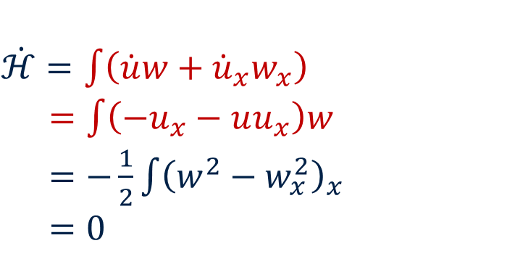
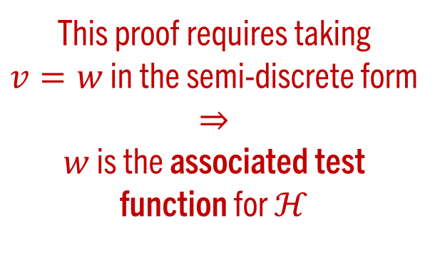
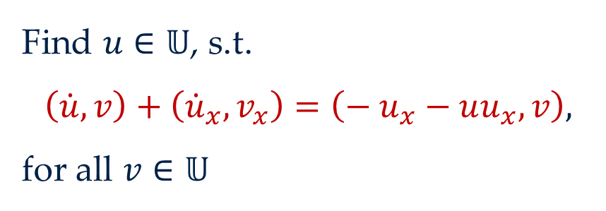
2. EXAMPLE (BBM) | 2. TEST FUNCTION IDENTIFICATION
B. Identify associated test functions
For each structure to be preserved, identify its associated test function
Each conservation/dissipation structure has an “associated test function”
Semi-discretisation
$\dot{ℋ}=\int{\left(\dot{u}w+{\dot{u}}_{x}w_{x}\right)}$
$=\int{\left(−u_{x}−uu_{x}\right)w}$
$=−\frac{1}{2}\int{{\left(w^{2}−w_{x}^{2}\right)}_{x}}$
$=0$
Find $u∈𝕌$, s.t.
$$\left(\dot{u},v\right)+\left({\dot{u}}_{x},v_{x}\right)=\left(− u_{x}−uu_{x},v\right),$$
for all $v∈𝕌$
This proof requires taking $v=w$ in the semi-discrete form
$$⇒$$
$w$ is the associated test function for $ℋ$

Slide 40
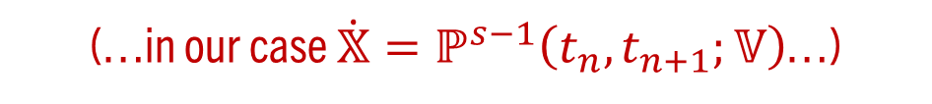
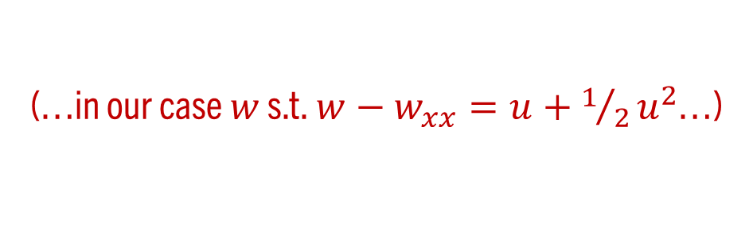
2. EXAMPLE (BBM) | 2. TEST FUNCTION IDENTIFICATION
If those associated test functions…
(…in our case $w$ s.t. $w−w_{xx}=u+1/2u^{2}$…)
…live in the CPG test space…
(…in our case $\dot{𝕏}=ℙ^{s−1}\left(t_{n},t_{n+1};𝕍\right)$…)
…then the structure is preserved discretely for free! ☺
$$ℋ\left(t_{n+1}\right)−ℋ\left(t_{n}\right)=\int_{t_{n}}^{t_{n+1}}{\dot{ℋ}}=\int_{t_{n}}^{t_{n+1}}{\left(\dot{u},w\right)+\left({\dot{u}}_{x},w_{x}\right)}=\int_{t_{n}}^{t_{n+1}}{\left(− u_{x}−uu_{x},w\right)}$$

Slide 41

2. EXAMPLE (BBM) | 2. TEST FUNCTION IDENTIFICATION
If those associated test functions…
(…in our case $w$ s.t. $w−w_{xx}=u+1/2u^{2}$…)
…live in the CPG test space…
(…in our case $\dot{𝕏}=ℙ^{s−1}\left(t_{n},t_{n+1};𝕍\right)$…)
…then the structure is preserved discretely for free! ☺
$$ℋ\left(t_{n+1}\right)−ℋ\left(t_{n}\right)=\int_{t_{n}}^{t_{n+1}}{\dot{ℋ}}=\int_{t_{n}}^{t_{n+1}}{\left(\dot{u},w\right)+\left({\dot{u}}_{x},w_{x}\right)}=\int_{t_{n}}^{t_{n+1}}{\left(− u_{x}−uu_{x},w\right)}$$

Slide 42
2. EXAMPLE (BBM) | 2. TEST FUNCTION IDENTIFICATION
If those associated test functions…
(…in our case $w$ s.t. $w−w_{xx}=u+1/2u^{2}$…)
…live in the CPG test space…
(…in our case $\dot{𝕏}=ℙ^{s−1}\left(t_{n},t_{n+1};𝕍\right)$…)
…then the structure is preserved discretely for free! ☺
$$ℋ\left(t_{n+1}\right)−ℋ\left(t_{n}\right)=\int_{t_{n}}^{t_{n+1}}{\dot{ℋ}}=\int_{t_{n}}^{t_{n+1}}{\left(\dot{u},w\right)+\left({\dot{u}}_{x},w_{x}\right)}=\int_{t_{n}}^{t_{n+1}}{\left(− u_{x}−uu_{x},w\right)}$$

Slide 43
2. EXAMPLE (BBM) | 2. TEST FUNCTION IDENTIFICATION
If those associated test functions…
(…in our case $w$ s.t. $w−w_{xx}=u+1/2u^{2}$…)
…live in the CPG test space…
(…in our case $\dot{𝕏}=ℙ^{s−1}\left(t_{n},t_{n+1};𝕍\right)$…)
…then the structure is preserved discretely for free! ☺
$$ℋ\left(t_{n+1}\right)−ℋ\left(t_{n}\right)=\int_{t_{n}}^{t_{n+1}}{\dot{ℋ}}=\int_{t_{n}}^{t_{n+1}}{\left(\dot{u},w\right)+\left({\dot{u}}_{x},w_{x}\right)}=\int_{t_{n}}^{t_{n+1}}{\left(− u_{x}−uu_{x},w\right)}$$

Slide 44
2. EXAMPLE (BBM) | 2. TEST FUNCTION IDENTIFICATION
If those associated test functions…
(…in our case $w$ s.t. $w−w_{xx}=u+1/2u^{2}$…)
…live in the CPG test space…
(…in our case $\dot{𝕏}=ℙ^{s−1}\left(t_{n},t_{n+1};𝕍\right)$…)
…then the structure is preserved discretely for free! ☺
$$ℋ\left(t_{n+1}\right)−ℋ\left(t_{n}\right)=\int_{t_{n}}^{t_{n+1}}{\dot{ℋ}}=\int_{t_{n}}^{t_{n+1}}{\left(\dot{u},w\right)+\left({\dot{u}}_{x},w_{x}\right)}=\int_{t_{n}}^{t_{n+1}}{\left(−{\left(w−w_{xx}\right)}_{x},w\right)}=0$$

Slide 45

2. EXAMPLE (BBM) | 2. TEST FUNCTION IDENTIFICATION
If those associated test functions…
(…in our case $w$ s.t. $w−w_{xx}=u+1/2u^{2}$…)
…live in the CPG test space…
(…in our case $\dot{𝕏}=ℙ^{s−1}\left(t_{n},t_{n+1};𝕍\right)$…)
…then the structure is preserved discretely for free! ☺
$$ℋ\left(t_{n+1}\right)−ℋ\left(t_{n}\right)=\int_{t_{n}}^{t_{n+1}}{\dot{ℋ}}=\int_{t_{n}}^{t_{n+1}}{\left(\dot{u},w\right)+\left({\dot{u}}_{x},w_{x}\right)}=\int_{t_{n}}^{t_{n+1}}{\left(−{\left(w−w_{xx}\right)}_{x},w\right)}=0$$

Slide 46
2. EXAMPLE (BBM) | 2. TEST FUNCTION IDENTIFICATION
The problem…
…this will, like, never happen

Slide 47
2. EXAMPLE (BBM)
1. TIMESTEPPING DEFINITION
2. TEST FUNCTION IDENTIFICATION
3. AV INTRODUCTION
4. RHS MODIFICATION

Slide 48

2. EXAMPLE (BBM) | 3. AV INTRODUCTION
The solution…
…introduce an AV for each associated test function that lives in the CPG test space
C. Introduce AVs in the CPG test space
For each associated test function, introduce a corresponding AV

Slide 49
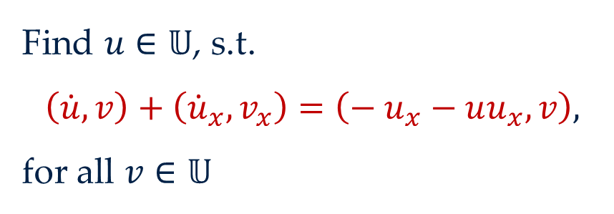
2. EXAMPLE (BBM) | 3. AV INTRODUCTION
Semi-discretisation
These AVs must be projections under the inner product acting on the time derivative in the semi-discrete form
Find $u∈𝕌$, s.t.
$$\left(\dot{u},v\right)+\left({\dot{u}}_{x},v_{x}\right)=\left(− u_{x}−uu_{x},v\right),$$
for all $v∈𝕌$
C. Introduce AVs in the CPG test space
For each associated test function, introduce a corresponding AV
WHY…?

Slide 50
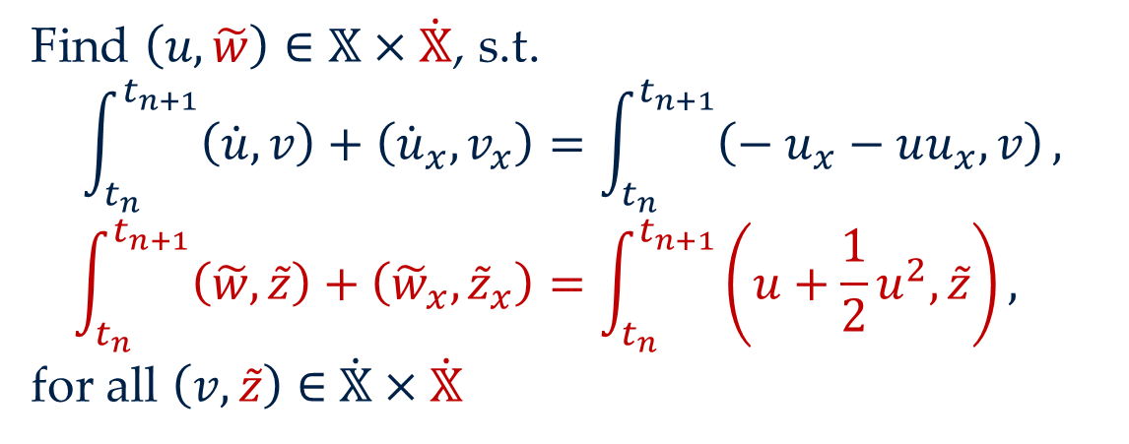
2. EXAMPLE (BBM) | 3. AV INTRODUCTION
Full CPG discretisation + AVs
Find $\left(u,\tilde{w}\right)∈𝕏×\dot{𝕏}$, s.t.
$$\int_{t_{n}}^{t_{n+1}}{\left(\dot{u},v\right)+\left({\dot{u}}_{x},v_{x}\right)}=\int_{t_{n}}^{t_{n+1}}{\left(− u_{x}−uu_{x},v\right)},$$
$$\int_{t_{n}}^{t_{n+1}}{\left(\tilde{w},\tilde{z}\right)+\left({\tilde{w}}_{x},{\tilde{z}}_{x}\right)}=\int_{t_{n}}^{t_{n+1}}{\left(u+\frac{1}{2}u^{2},\tilde{z}\right)},$$
for all $\left(v,\tilde{z}\right)∈$ $\dot{𝕏}×\dot{𝕏}$
$$ℋ\left(t_{n+1}\right)−ℋ\left(t_{n}\right)=\int_{t_{n}}^{t_{n+1}}{\dot{ℋ}}=\int_{t_{n}}^{t_{n+1}}{\left(u+\frac{1}{2}u^{2},\dot{u}\right)}=\int_{t_{n}}^{t_{n+1}}{\left(w,\dot{u}\right)+\left(w_{x},{\dot{u}}_{x}\right)}=\int_{t_{n}}^{t_{n+1}}{\left(− u_{x}−uu_{x},w\right)}$$

Slide 51
2. EXAMPLE (BBM) | 3. AV INTRODUCTION
Full CPG discretisation + AVs
Find $\left(u,\tilde{w}\right)∈𝕏×\dot{𝕏}$, s.t.
$$\int_{t_{n}}^{t_{n+1}}{\left(\dot{u},v\right)+\left({\dot{u}}_{x},v_{x}\right)}=\int_{t_{n}}^{t_{n+1}}{\left(− u_{x}−uu_{x},v\right)},$$
$$\int_{t_{n}}^{t_{n+1}}{\left(\tilde{w},\tilde{z}\right)+\left({\tilde{w}}_{x},{\tilde{z}}_{x}\right)}=\int_{t_{n}}^{t_{n+1}}{\left(u+\frac{1}{2}u^{2},\tilde{z}\right)},$$
for all $\left(v,\tilde{z}\right)∈$ $\dot{𝕏}×\dot{𝕏}$
$$ℋ\left(t_{n+1}\right)−ℋ\left(t_{n}\right)=\int_{t_{n}}^{t_{n+1}}{\dot{ℋ}}=\int_{t_{n}}^{t_{n+1}}{\left(u+\frac{1}{2}u^{2},\dot{u}\right)}=\int_{t_{n}}^{t_{n+1}}{\left(w,\dot{u}\right)+\left(w_{x},{\dot{u}}_{x}\right)}=\int_{t_{n}}^{t_{n+1}}{\left(− u_{x}−uu_{x},w\right)}$$

Slide 52
2. EXAMPLE (BBM) | 3. AV INTRODUCTION
Full CPG discretisation + AVs
Find $\left(u,\tilde{w}\right)∈𝕏×\dot{𝕏}$, s.t.
$$\int_{t_{n}}^{t_{n+1}}{\left(\dot{u},v\right)+\left({\dot{u}}_{x},v_{x}\right)}=\int_{t_{n}}^{t_{n+1}}{\left(− u_{x}−uu_{x},v\right)},$$
$$\int_{t_{n}}^{t_{n+1}}{\left(\tilde{w},\tilde{z}\right)+\left({\tilde{w}}_{x},{\tilde{z}}_{x}\right)}=\int_{t_{n}}^{t_{n+1}}{\left(u+\frac{1}{2}u^{2},\tilde{z}\right)},$$
for all $\left(v,\tilde{z}\right)∈$ $\dot{𝕏}×\dot{𝕏}$
$$ℋ\left(t_{n+1}\right)−ℋ\left(t_{n}\right)=\int_{t_{n}}^{t_{n+1}}{\dot{ℋ}}=\int_{t_{n}}^{t_{n+1}}{\left(u+\frac{1}{2}u^{2},\dot{u}\right)}=\int_{t_{n}}^{t_{n+1}}{\left(w,\dot{u}\right)+\left(w_{x},{\dot{u}}_{x}\right)}=\int_{t_{n}}^{t_{n+1}}{\left(− u_{x}−uu_{x},w\right)}$$

Slide 53
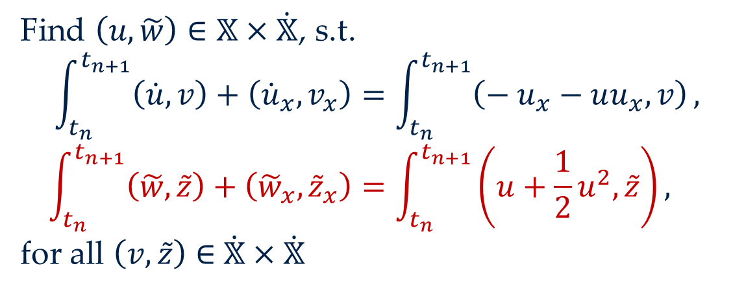
2. EXAMPLE (BBM) | 3. AV INTRODUCTION
Full CPG discretisation + AVs
Find $\left(u,\tilde{w}\right)∈𝕏×\dot{𝕏}$, s.t.
$$\int_{t_{n}}^{t_{n+1}}{\left(\dot{u},v\right)+\left({\dot{u}}_{x},v_{x}\right)}=\int_{t_{n}}^{t_{n+1}}{\left(− u_{x}−uu_{x},v\right)},$$
$$\int_{t_{n}}^{t_{n+1}}{\left(\tilde{w},\tilde{z}\right)+\left({\tilde{w}}_{x},{\tilde{z}}_{x}\right)}=\int_{t_{n}}^{t_{n+1}}{\left(u+\frac{1}{2}u^{2},\tilde{z}\right)},$$
for all $\left(v,\tilde{z}\right)∈$ $\dot{𝕏}×\dot{𝕏}$
$$ℋ\left(t_{n+1}\right)−ℋ\left(t_{n}\right)=\int_{t_{n}}^{t_{n+1}}{\dot{ℋ}}=\int_{t_{n}}^{t_{n+1}}{\left(u+\frac{1}{2}u^{2},\dot{u}\right)}=\int_{t_{n}}^{t_{n+1}}{\left(w,\dot{u}\right)+\left(w_{x},{\dot{u}}_{x}\right)}=\int_{t_{n}}^{t_{n+1}}{\left(− u_{x}−uu_{x},w\right)}$$

Slide 54
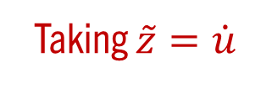
2. EXAMPLE (BBM) | 3. AV INTRODUCTION
Full CPG discretisation + AVs
This is why we needed CPG!!
Find $\left(u,\tilde{w}\right)∈𝕏×\dot{𝕏}$, s.t.
$$\int_{t_{n}}^{t_{n+1}}{\left(\dot{u},v\right)+\left({\dot{u}}_{x},v_{x}\right)}=\int_{t_{n}}^{t_{n+1}}{\left(− u_{x}−uu_{x},v\right)},$$
$$\int_{t_{n}}^{t_{n+1}}{\left(\tilde{w},\tilde{z}\right)+\left({\tilde{w}}_{x},{\tilde{z}}_{x}\right)}=\int_{t_{n}}^{t_{n+1}}{\left(u+\frac{1}{2}u^{2},\tilde{z}\right)},$$
for all $\left(v,\tilde{z}\right)∈$ $\dot{𝕏}×\dot{𝕏}$
Defining the AVs in this way let’s us pass “via” them in our proof
Taking $\tilde{z}=\dot{u}$
$$ℋ\left(t_{n+1}\right)−ℋ\left(t_{n}\right)=\int_{t_{n}}^{t_{n+1}}{\dot{ℋ}}=\int_{t_{n}}^{t_{n+1}}{\left(u+\frac{1}{2}u^{2},\dot{u}\right)}=\int_{t_{n}}^{t_{n+1}}{\left(\tilde{w},\dot{u}\right)+\left({\tilde{w}}_{x},{\dot{u}}_{x}\right)}=\int_{t_{n}}^{t_{n+1}}{\left(− u_{x}−uu_{x},w\right)}$$

Slide 55
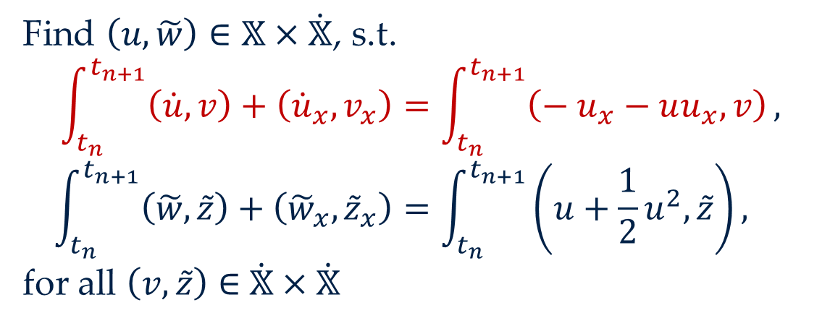
2. EXAMPLE (BBM) | 3. AV INTRODUCTION
Full CPG discretisation + AVs
This is why we needed CPG!!
Find $\left(u,\tilde{w}\right)∈𝕏×\dot{𝕏}$, s.t.
$$\int_{t_{n}}^{t_{n+1}}{\left(\dot{u},v\right)+\left({\dot{u}}_{x},v_{x}\right)}=\int_{t_{n}}^{t_{n+1}}{\left(− u_{x}−uu_{x},v\right)},$$
$$\int_{t_{n}}^{t_{n+1}}{\left(\tilde{w},\tilde{z}\right)+\left({\tilde{w}}_{x},{\tilde{z}}_{x}\right)}=\int_{t_{n}}^{t_{n+1}}{\left(u+\frac{1}{2}u^{2},\tilde{z}\right)},$$
for all $\left(v,\tilde{z}\right)∈$ $\dot{𝕏}×\dot{𝕏}$
Defining the AVs in this way let’s us pass “via” them in our proof
$$ℋ\left(t_{n+1}\right)−ℋ\left(t_{n}\right)=\int_{t_{n}}^{t_{n+1}}{\dot{ℋ}}=\int_{t_{n}}^{t_{n+1}}{\left(u+\frac{1}{2}u^{2},\dot{u}\right)}=\int_{t_{n}}^{t_{n+1}}{\left(\tilde{w},\dot{u}\right)+\left({\tilde{w}}_{x},{\dot{u}}_{x}\right)}=\int_{t_{n}}^{t_{n+1}}{\left(− u_{x}−uu_{x},w\right)}$$

Slide 56

2. EXAMPLE (BBM) | 3. AV INTRODUCTION
Full CPG discretisation + AVs
This is why we needed CPG!!
Find $\left(u,\tilde{w}\right)∈𝕏×\dot{𝕏}$, s.t.
$$\int_{t_{n}}^{t_{n+1}}{\left(\dot{u},v\right)+\left({\dot{u}}_{x},v_{x}\right)}=\int_{t_{n}}^{t_{n+1}}{\left(− u_{x}−uu_{x},v\right)},$$
$$\int_{t_{n}}^{t_{n+1}}{\left(\tilde{w},\tilde{z}\right)+\left({\tilde{w}}_{x},{\tilde{z}}_{x}\right)}=\int_{t_{n}}^{t_{n+1}}{\left(u+\frac{1}{2}u^{2},\tilde{z}\right)},$$
for all $\left(v,\tilde{z}\right)∈$ $\dot{𝕏}×\dot{𝕏}$
Defining the AVs in this way let’s us pass “via” them in our proof
Taking $v=\tilde{w}$
$$ℋ\left(t_{n+1}\right)−ℋ\left(t_{n}\right)=\int_{t_{n}}^{t_{n+1}}{\dot{ℋ}}=\int_{t_{n}}^{t_{n+1}}{\left(u+\frac{1}{2}u^{2},\dot{u}\right)}=\int_{t_{n}}^{t_{n+1}}{\left(\tilde{w},\dot{u}\right)+\left({\tilde{w}}_{x},{\dot{u}}_{x}\right)}=\int_{t_{n}}^{t_{n+1}}{\left(− u_{x}−uu_{x},\tilde{w}\right)}$$

Slide 57

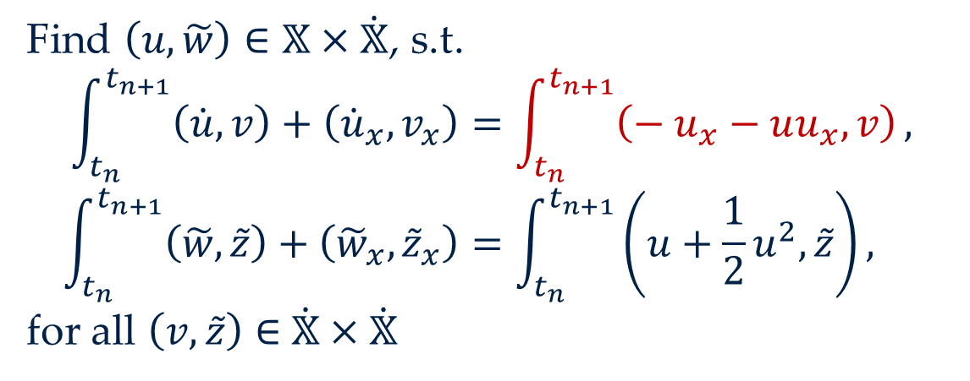
2. EXAMPLE (BBM) | 3. AV INTRODUCTION
SO, IF WE REWRITE THIS IN TERMS OF $\tilde{w}$, WE’RE DONE!
Full CPG discretisation + AVs
This is why we needed CPG!!
Find $\left(u,\tilde{w}\right)∈𝕏×\dot{𝕏}$, s.t.
$$\int_{t_{n}}^{t_{n+1}}{\left(\dot{u},v\right)+\left({\dot{u}}_{x},v_{x}\right)}=\int_{t_{n}}^{t_{n+1}}{\left(− u_{x}−uu_{x},v\right)},$$
$$\int_{t_{n}}^{t_{n+1}}{\left(\tilde{w},\tilde{z}\right)+\left({\tilde{w}}_{x},{\tilde{z}}_{x}\right)}=\int_{t_{n}}^{t_{n+1}}{\left(u+\frac{1}{2}u^{2},\tilde{z}\right)},$$
for all $\left(v,\tilde{z}\right)∈$ $\dot{𝕏}×\dot{𝕏}$
Defining the AVs in this way let’s us pass “via” them in our proof
$$ℋ\left(t_{n+1}\right)−ℋ\left(t_{n}\right)=\int_{t_{n}}^{t_{n+1}}{\dot{ℋ}}=\int_{t_{n}}^{t_{n+1}}{\left(u+\frac{1}{2}u^{2},\dot{u}\right)}=\int_{t_{n}}^{t_{n+1}}{\left(\tilde{w},\dot{u}\right)+\left({\tilde{w}}_{x},{\dot{u}}_{x}\right)}=\int_{t_{n}}^{t_{n+1}}{\left(− u_{x}−uu_{x},\tilde{w}\right)}$$

Slide 58
2. EXAMPLE (BBM)
1. TIMESTEPPING DEFINITION
2. TEST FUNCTION IDENTIFICATION
3. AV INTRODUCTION
4. RHS MODIFICATION

Slide 59
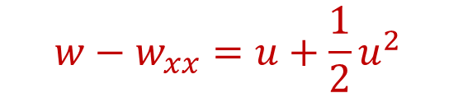
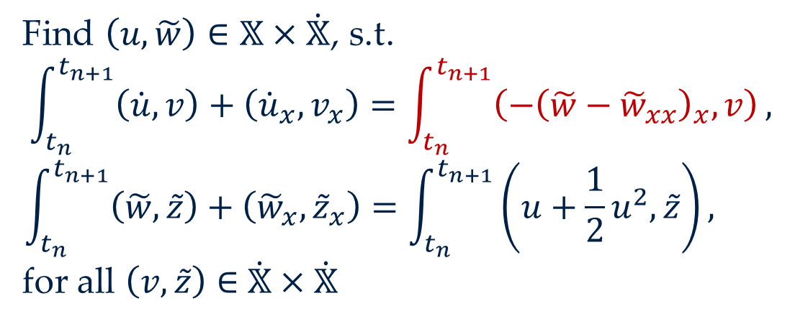
2. EXAMPLE (BBM) | 4. RHS MODIFICATION
Energy-conserving discretisation
C. Modify the RHS of the original equation
Find $\left(u,\tilde{w}\right)∈𝕏×\dot{𝕏}$, s.t.
$$\int_{t_{n}}^{t_{n+1}}{\left(\dot{u},v\right)+\left({\dot{u}}_{x},v_{x}\right)}=\int_{t_{n}}^{t_{n+1}}{\left(−{\left(\tilde{w}−{\tilde{w}}_{xx}\right)}_{x},v\right)},$$
$$\int_{t_{n}}^{t_{n+1}}{\left(\tilde{w},\tilde{z}\right)+\left({\tilde{w}}_{x},{\tilde{z}}_{x}\right)}=\int_{t_{n}}^{t_{n+1}}{\left(u+\frac{1}{2}u^{2},\tilde{z}\right)},$$
for all $\left(v,\tilde{z}\right)∈$ $\dot{𝕏}×\dot{𝕏}$
Introduce the AVs into the RHS of our original equation, in a way that reproduces the desired structures
$$w−w_{xx}=u+\frac{1}{2}u^{2}$$
$$\dot{u}−{\dot{u}}_{xx}=−u_{x}−uu_{x}=−{\left(w−w_{xx}\right)}_{x}$$

Slide 60
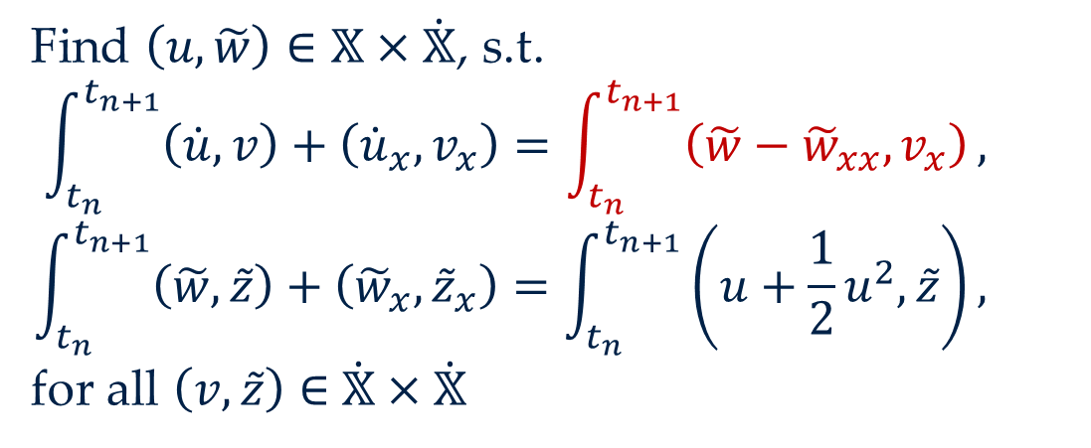
2. EXAMPLE (BBM) | 4. RHS MODIFICATION
Energy-conserving discretisation
C. Modify the RHS of the original equation
Find $\left(u,\tilde{w}\right)∈𝕏×\dot{𝕏}$, s.t.
$$\int_{t_{n}}^{t_{n+1}}{\left(\dot{u},v\right)+\left({\dot{u}}_{x},v_{x}\right)}=\int_{t_{n}}^{t_{n+1}}{\left(\tilde{w}−{\tilde{w}}_{xx},v_{x}\right)},$$
$$\int_{t_{n}}^{t_{n+1}}{\left(\tilde{w},\tilde{z}\right)+\left({\tilde{w}}_{x},{\tilde{z}}_{x}\right)}=\int_{t_{n}}^{t_{n+1}}{\left(u+\frac{1}{2}u^{2},\tilde{z}\right)},$$
for all $\left(v,\tilde{z}\right)∈$ $\dot{𝕏}×\dot{𝕏}$
Introduce the AVs into the RHS of our original equation, in a way that reproduces the desired structures
$$w−w_{xx}=u+\frac{1}{2}u^{2}$$
$$\dot{u}−{\dot{u}}_{xx}=−u_{x}−uu_{x}=−{\left(w−w_{xx}\right)}_{x}$$

Slide 61
2. EXAMPLE (BBM) | 4. RHS MODIFICATION
Energy-conserving discretisation
C. Modify the RHS of the original equation
Find $\left(u,\tilde{w}\right)∈𝕏×\dot{𝕏}$, s.t.
$$\int_{t_{n}}^{t_{n+1}}{\left(\dot{u},v\right)+\left({\dot{u}}_{x},v_{x}\right)}=\int_{t_{n}}^{t_{n+1}}{\left(\tilde{w}−{\tilde{w}}_{xx},v_{x}\right)},$$
$$\int_{t_{n}}^{t_{n+1}}{\left(\tilde{w},\tilde{z}\right)+\left({\tilde{w}}_{x},{\tilde{z}}_{x}\right)}=\int_{t_{n}}^{t_{n+1}}{\left(u+\frac{1}{2}u^{2},\tilde{z}\right)},$$
for all $\left(v,\tilde{z}\right)∈$ $\dot{𝕏}×\dot{𝕏}$
Introduce the AVs into the RHS of our original equation, in a way that reproduces the desired structures
$$ℋ\left(t_{n+1}\right)−ℋ\left(t_{n}\right)=…=\int_{t_{n}}^{t_{n+1}}{\left(\tilde{w},\dot{u}\right)+\left({\tilde{w}}_{x},{\dot{u}}_{x}\right)}=\int_{t_{n}}^{t_{n+1}}{\left(\tilde{w}−{\tilde{w}}_{xx},{\tilde{w}}_{x}\right)}=0$$

Slide 62
2. EXAMPLE (BBM) | 4. RHS MODIFICATION
Energy-conserving discretisation
C. Modify the RHS of the original equation
Find $\left(u,\tilde{w}\right)∈𝕏×\dot{𝕏}$, s.t.
$$\int_{t_{n}}^{t_{n+1}}{\left(\dot{u},v\right)+\left({\dot{u}}_{x},v_{x}\right)}=\int_{t_{n}}^{t_{n+1}}{\left(\tilde{w}−{\tilde{w}}_{xx},v_{x}\right)},$$
$$\int_{t_{n}}^{t_{n+1}}{\left(\tilde{w},\tilde{z}\right)+\left({\tilde{w}}_{x},{\tilde{z}}_{x}\right)}=\int_{t_{n}}^{t_{n+1}}{\left(u+\frac{1}{2}u^{2},\tilde{z}\right)},$$
for all $\left(v,\tilde{z}\right)∈$ $\dot{𝕏}×\dot{𝕏}$
Introduce the AVs into the RHS of our original equation, in a way that reproduces the desired structures
$$ℋ\left(t_{n+1}\right)−ℋ\left(t_{n}\right)=…=\int_{t_{n}}^{t_{n+1}}{\left(\tilde{w},\dot{u}\right)+\left({\tilde{w}}_{x},{\dot{u}}_{x}\right)}=\int_{t_{n}}^{t_{n+1}}{\left(\tilde{w}−{\tilde{w}}_{xx},{\tilde{w}}_{x}\right)}=0$$

Slide 63
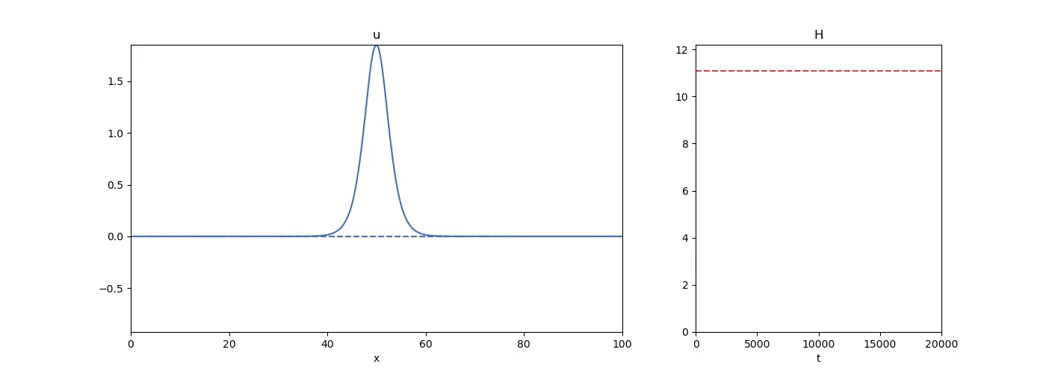
2. EXAMPLE (BBM) | 4. RHS MODIFICATION
$$u$$
Energy

Slide 64

2. EXAMPLE (BBM) | 4. RHS MODIFICATION
$$u$$
Energy

Slide 65
3. FRAMEWORK SUMMARY

Slide 66
3. FRAMEWORK SUMMARY
The framework
Define initial CPG scheme
For each structure to preserve, identify certain “associated test function”
For each associated test function, introduce corresponding AV
Modify RHS of initial system
Notes:
The steps of our framework I’ll highlight in purple, to highlight them, and because it’s a fun colour I’ve not used yet

Slide 67
4. APPLICATIONS

Slide 68

4. APPLICATIONS
From the preprint…
Integrators for conservative ODEs that conserve all known invariants
Integrators for compressible Navier–Stokes that both conserve energy and dissipate entropy
From a recent submission with M. He, P. Farrell, K. Hu…
Topology-preserving integrators in MHD

Slide 69



4. APPLICATIONS
From my thesis / ongoing write-ups…
Energy and enstrophy–stable integrators for 2D NS
Asymptotic-preserving integrators for multiscale systems
Applications in high-$Re$ stabilisation

Slide 70

4. APPLICATIONS
From my thesis / ongoing write-ups…
Energy and enstrophy–stable integrators for 2D NS
Integrators for GENERIC systems that both conserve energy and dissipate entropy
Asymptotic-preserving integrators for multiscale systems
incl. Boltzmann!

Slide 71


4. APPLICATIONS
From my thesis / ongoing write-ups…
Energy and enstrophy–stable integrators for 2D NS
Integrators for GENERIC systems that both conserve energy and dissipate entropy
Asymptotic-preserving integrators for multiscale systems
From the future…?
Viscoelastic / Oldroyd-B fluids
Structure-preserving methods for BVPs with non-zero BCs

Slide 72
4. APPLICATIONS
From my thesis / ongoing write-ups…
Energy and enstrophy–stable integrators for 2D NS
Integrators for GENERIC systems that both conserve energy and dissipate entropy
Asymptotic-preserving integrators for multiscale systems
From the future…?
Viscoelastic / Oldroyd-B fluids
Geometric PDEs / Numerical relativity
Structure-preserving methods for BVPs with non-zero BCs

Slide 73
Interested in anything! ☺

Slide 74
THANKS!
borisandrews.github.io
boris.andrews@maths.ox.ac.uk

